Slide 1
Satellites - Lab0
Extra Reading Material

Slide 2
🛰 How are Satellites Related to Spatial Data?
Satellite images are a type of spatial data, specifically, they fall under the raster data category.

Slide 3
📍 What is Spatial Data?
Spatial data, also known as geo-spatial data, encapsulates information about the physical locations and characteristics of natural or constructed features and boundaries on Earth.
There are two main types of spatial data:
Vector Data
Raster Data
Other types are used along with them
Attribute Data
Temporal Data

Slide 4
Vector Data
Vector data uses points, lines, and polygons to represent spatial features.
✅ Best for representing:
Points (e.g., landmarks, trees)
Lines (e.g., roads, rivers)
Polygons (e.g., buildings, land parcels)
🏙 Example (Urban Planning): A city map where:
Streets are lines
Buildings are polygons
Landmarks are points
📂 Common Formats:
Shapefile
GeoJSON

Slide 5
Raster Data
Raster data is essentially pixel-based data, where each pixel has a value representing information such as:
Elevation
Temperature
Land Cover
Satellite Imagery
✅ Best for representing:
Continuous data
🏙 Example: A satellite image showing vegetation cover, where each pixel represents the amount of greenery.
📂 Common Formats:
TIFF
GeoTIFF

Slide 6
Attribute Data
Both vector and raster data often come with associated attribute data. This is additional information that describes the characteristics of the spatial features.
Example: A pixel may have the attribute Acquisition Date: 2024-02-10, indicating when the data was captured.
Temporal Data
In many applications, spatial data is also associated with a specific time or time range, known as temporal data.
Example: A satellite image (raster data) may be timestamped to indicate when it was captured.

Slide 7
Libraries We’ll Use
Earthpy
Purpose: A Python package that makes it easier to plot and work with spatial raster and vector data using open-source tools. High-level helper functions simplify geospatial workflows & visualization.
Integration: Earthpy depends upon
geopandas, which extends pandas and has a focus on vector data
rasterio, based on gdal, with facilitates input and output of raster data files.
GDAL
Purpose: Low-level geospatial data processing.
Integration: Used in rasterio, geopandas, earthpy.
Performance: High-performance, C++ backend.

Slide 8
Why use TIFFs?
What’s wrong with PNGs?!

Slide 9
TIFF versus PNG
Feature | TIFF | PNG
Full Name | Tagged Image File Format | Portable Network Graphics
File Extension | .tif, .tiff | .png
Compression | Lossless (LZW, PackBits) or uncompressed | Lossless (DEFLATE)
Multi-Layer Support | ✅ Yes | ❌ No
Geospatial Support (GeoTIFF) | ✅ Yes | ❌ No
Best Used For | High-quality printing, GIS, remote sensing | Web images, icons, graphics
File Size | Large (can be uncompressed) | Smaller (compressed)
Color Depth | Supports CMYK, RGB, Grayscale, Multi-band | Supports RGB, Grayscale

Slide 10
TIFF Format: Multi-Layer Images
One Image with Multiple Layers A TIFF file can hold multiple layers within a single image, making it useful for various applications.
📌 Photoshop → A brochure design with separate text, background, and logo layers for easy editing. 📌 Satellite Imaging → A satellite image storing different spectral bands in separate layers (Red, Green, Blue, Infrared, etc.). 📌 Medical Imaging → Storing different views or processed versions of the same scan.

Slide 11
TIFF Format: Multi-Image Files
Multiple Images in One File A TIFF file can also store multiple images within a single file, making it useful for handling image sequences.
📌 Photoshop → A multi-page magazine or brochure saved as a single TIFF file. 📌 Satellite Imaging → A time-series dataset tracking deforestation from 2020 to 2022 in one file. 📌 Medical Imaging → A CT or MRI scan where each image slice represents a different depth of the body.

Slide 12
GeoTIFF
GeoTIFF is an extension of TIFF that includes georeferencing metadata (e.g. resolution).

Slide 13
Back to the true-color images,
How do we see them?

Slide 14
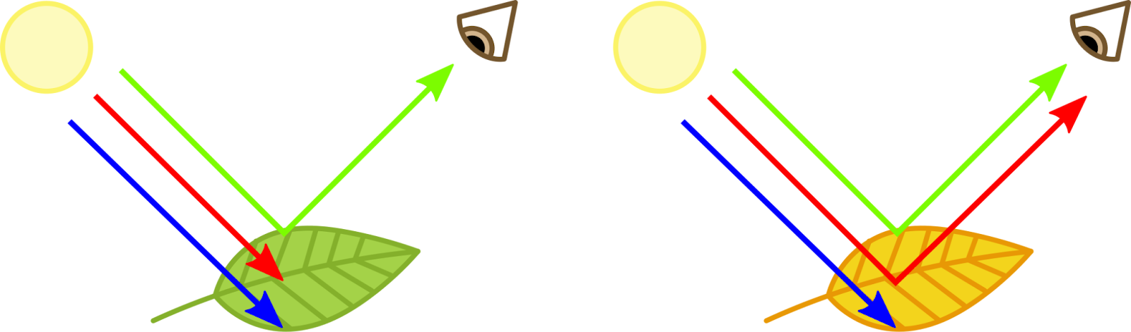

Slide 15
What about Multispectral images?

Slide 16
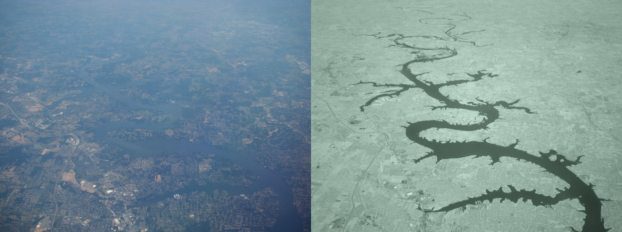

Slide 17
Multi-spectral Images
Most commonly, these images use bands of light from the infrared part of the light spectrum, in addition to those typically visible to the human eye.
Since we cannot typically see infrared light, we have to map the data on the light captured from these bands to visible ones
Directly map them to create a “false colour” image.
Band Ratios
Band Indices

Slide 18
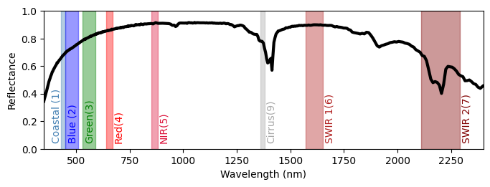
Case Study: detecting kaolinite using a False-color Image
We will use the bands in which the material reflects a high amount of light, alongside those in which it mostly absorbs light, to create a false colour composite.
The different bands are mapped to visible colours in our false colour image as follows:
SWIR 2 band (7) → Red
SWIR 1 band (6) → Green
Red band (4) → Blue

Slide 19
Which color should indicate
the kaolinite ?

Slide 20
Case Study: detecting kaolinite using a False-color Image
Based on the RGB mapping and the graph below, we expect low values in the red channel and high values in both the green and blue channels. This suggests that kaolinite should appear greenish-blue in the false-color image
SWIR 2 band (7) → Red
SWIR 1 band (6) → Green
Red band (4) → Blue

Slide 21
